Slide 1

Note: The data and information in this document is reflective of a hypothetical situation and client. This document is to be used for KPMG Virtual Internship purposes only.
Sprocket Central Pty Ltd
Data analytics approach
[Division Name] - [Engagement Manager], [Senior Consultant], [Junior Consultant]

Slide 2
Note: The data and information in this document is reflective of a hypothetical situation and client. This document is to be used for KPMG Virtual Internship purposes only.
Agenda
Introduction
Data Exploration
Model Development
Interpretation

Slide 3
Note: The data and information in this document is reflective of a hypothetical situation and client. This document is to be used for KPMG Virtual Internship purposes only.
Introduction
Customer Analysis
Wealth Segment distribution
Age Groups
Gender distribution
Past 3 year bike related purchases
Job Industry distribution

Slide 4
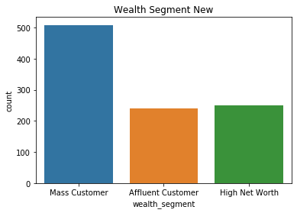
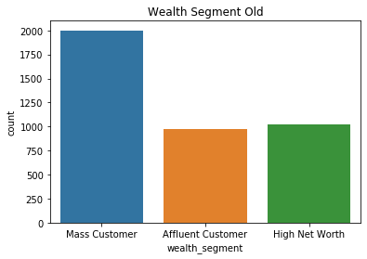
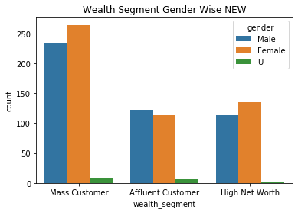
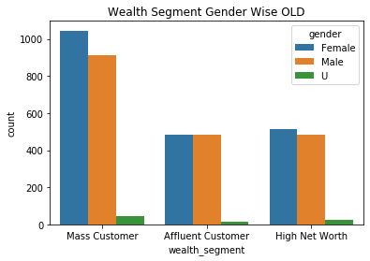
Note: The data and information in this document is reflective of a hypothetical situation and client. This document is to be used for KPMG Virtual Internship purposes only.
Data Exploration
Wealth Segment Distribution
Mass Customers have great majority in Wealth Segment so they should be more focused on.
And in Mass Customers Females have more majority.

Slide 5
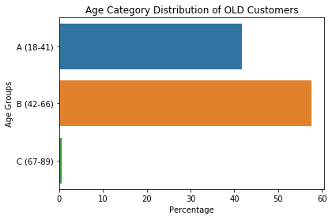
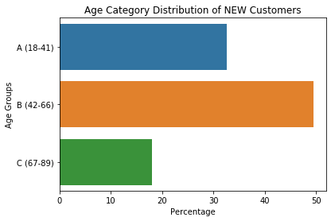
Note: The data and information in this document is reflective of a hypothetical situation and client. This document is to be used for KPMG Virtual Internship purposes only.
Data Exploration
Age Category Distribution
There is an huge increase in People belonging from age group (67-89) from 0.6% to 18%
There is an decrease in group-A category of age from 41.7% to 32%

Slide 6
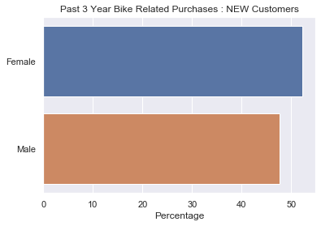
Note: The data and information in this document is reflective of a hypothetical situation and client. This document is to be used for KPMG Virtual Internship purposes only.
Model Development
Past 3 Year Bike Related Purhcases
We can observe that Females have purchased more bikes in last 3 years(52.3%) as compared to males.
Similar observation can be seen in Old customers also where females have purchased 51% of bikes in last 3 years.
So we can focus more & give advertisements to females more as compared to males.

Slide 7
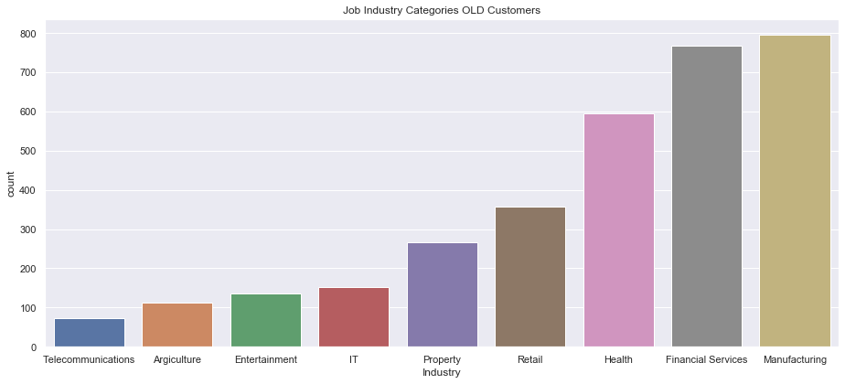
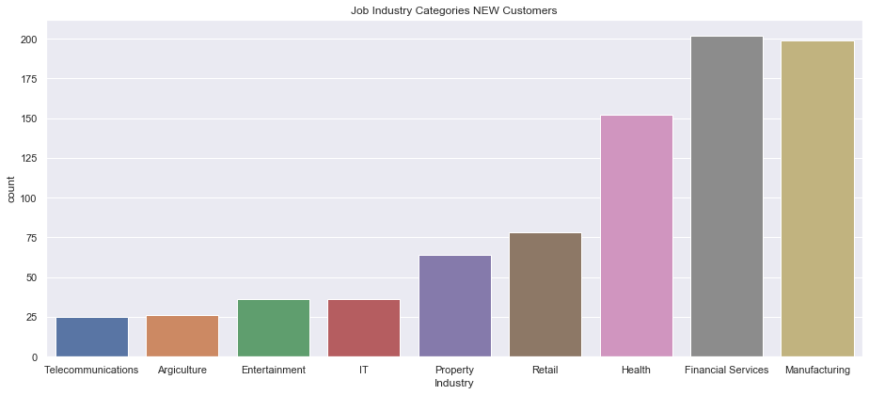
Note: The data and information in this document is reflective of a hypothetical situation and client. This document is to be used for KPMG Virtual Internship purposes only.
Interpretation
Job Industry Categories
We can observe that Financial Services and Manufacturing Industry continue to be most promising sectors as compared to others.
However, there is slight increment in Financial Services sector in our new customers from past trends rest industries continue to be same.

Slide 8
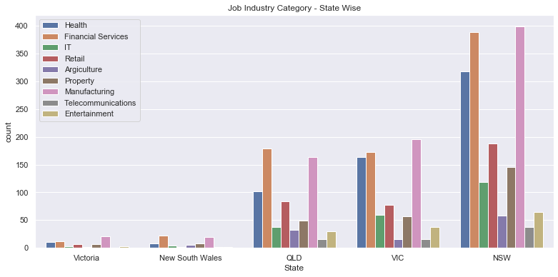
Note: The data and information in this document is reflective of a hypothetical situation and client. This document is to be used for KPMG Virtual Internship purposes only.
Interpretation
Job Industry Category – State Wise
States NSW is the most promising state among all, It had more customers so it should be more focused on.
And in NSW, Manufacturing Industries is the leading sector among all.

Slide 9
Note: The data and information in this document is reflective of a hypothetical situation and client. This document is to be used for KPMG Virtual Internship purposes only.
Appendix

Slide 10
Note: The data and information in this document is reflective of a hypothetical situation and client. This document is to be used for KPMG Virtual Internship purposes only.
Appendix
Codebook for the above analysis is attached with this presentation.

